Slide 1
EXPLORATORY DATA ANALYSIS
Amazon E-Commerce
Sales & Customer Behavior
Kavya Patel

Slide 2
Project Overview
Project objective
Time patterns
Spending
To explore when customers shop, how spending changes, and how purchasing patterns differ across countries and customers.
Comparing months, days and hours.
Look at amount spent and its distribution.
Countries
Customers
Tools used
Compare spending patterns by country.
Identify high-spending customers using their customer IDs.
• Pandas for cleaning and analysis
• Matplotlib and Seaborn for charts

Slide 3
Data Cleaning and Feature engineering
• Changed date and time fields into a clear format.
• Created separate date and time columns.
• Converted month numbers into month names.
• Converted weekday numbers into weekday names.
• Created a year column for easier grouping.
Why this has been done
Making the data more easy to understand and use .
Analysis fields
Date, month, day, country, customer ID and amount spent can be used to find some patterns and link between them.

Slide 4
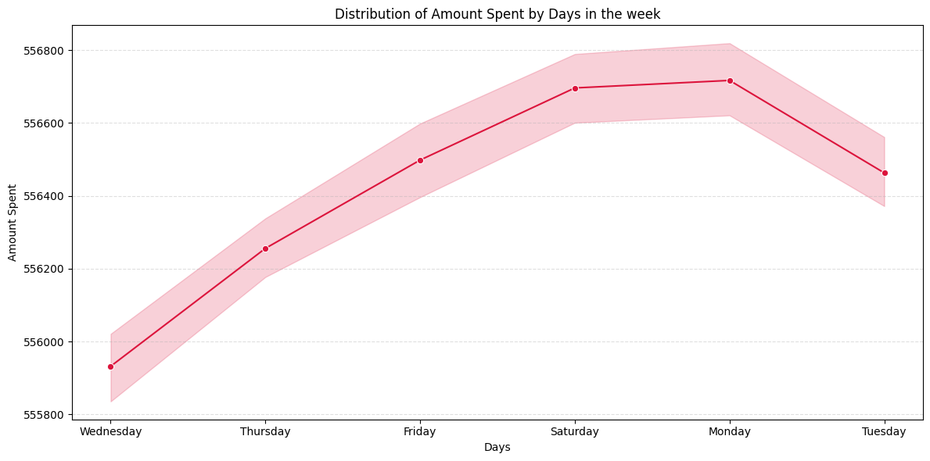
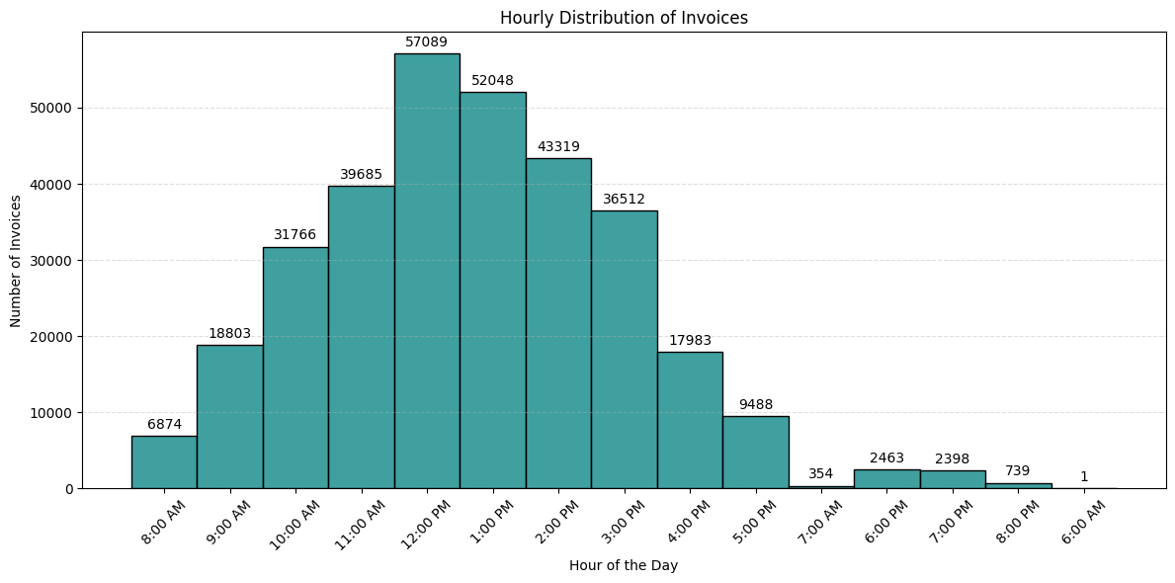
Charts for finding when the most amount is spent
Daily spending peaks on Monday and Saturday.
The most amount of selling happens between 10:00 AM to 03:00 PM of the day.

Slide 5
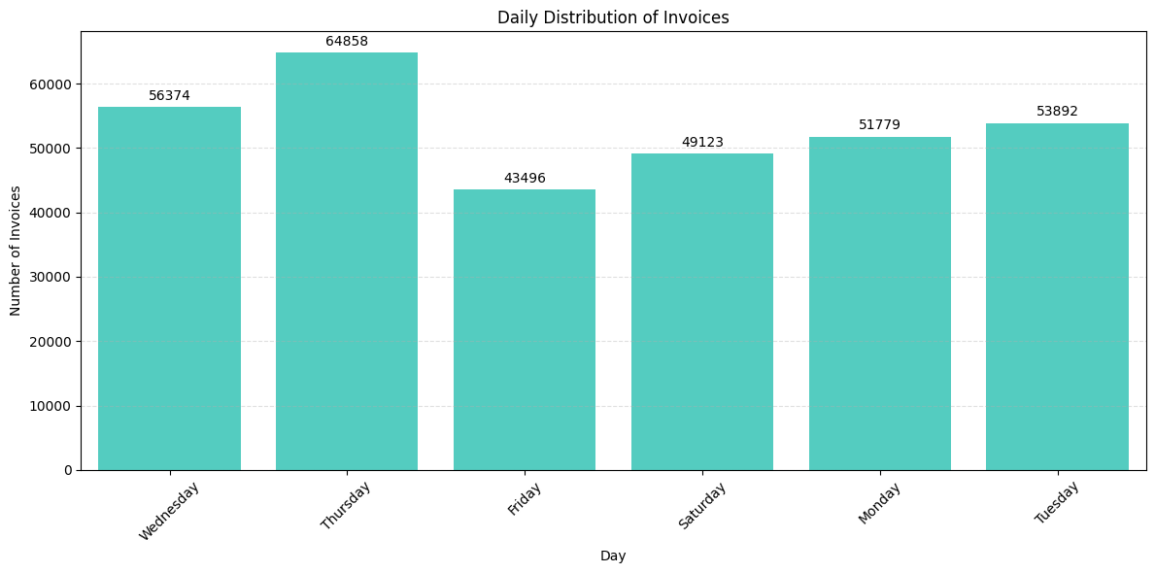
Number of Invoices by Day
Main observation
The most number of invoices are made on Thursday.
Possible use
The business can offer day related offers to attract more customers on other days.
Example
Lapino’z offers buy 1 get 1 free offer on Wednesday and Friday to increase their sale on those days along with the sales on the weekend.

Slide 6
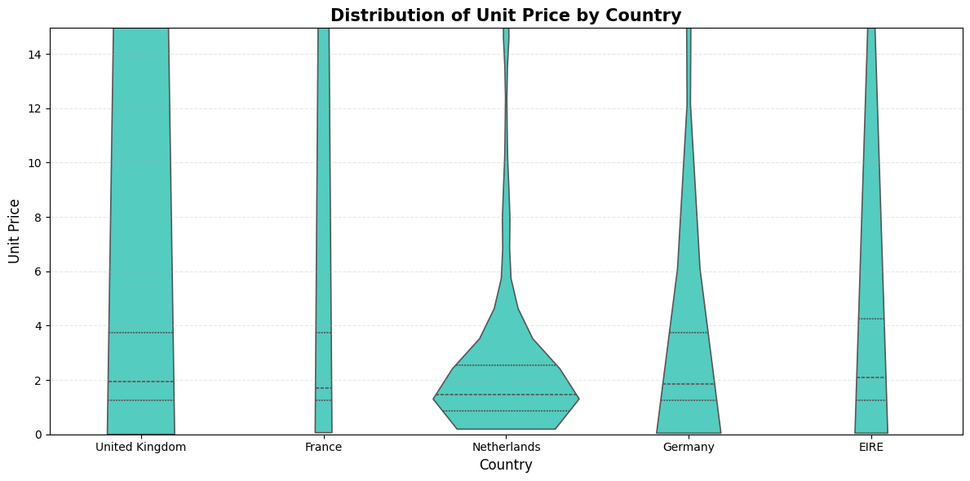
How much the customers spend according to the country
The range of spendings
The spending values are mostly around $1 - $14+ in the United Kingdom whereas $1 - $6 in other countries.
The spread of the data
The United Kingdoms have the most consistent spread of the data whereas Netherlands have variations in its spending by the customers.

Slide 7
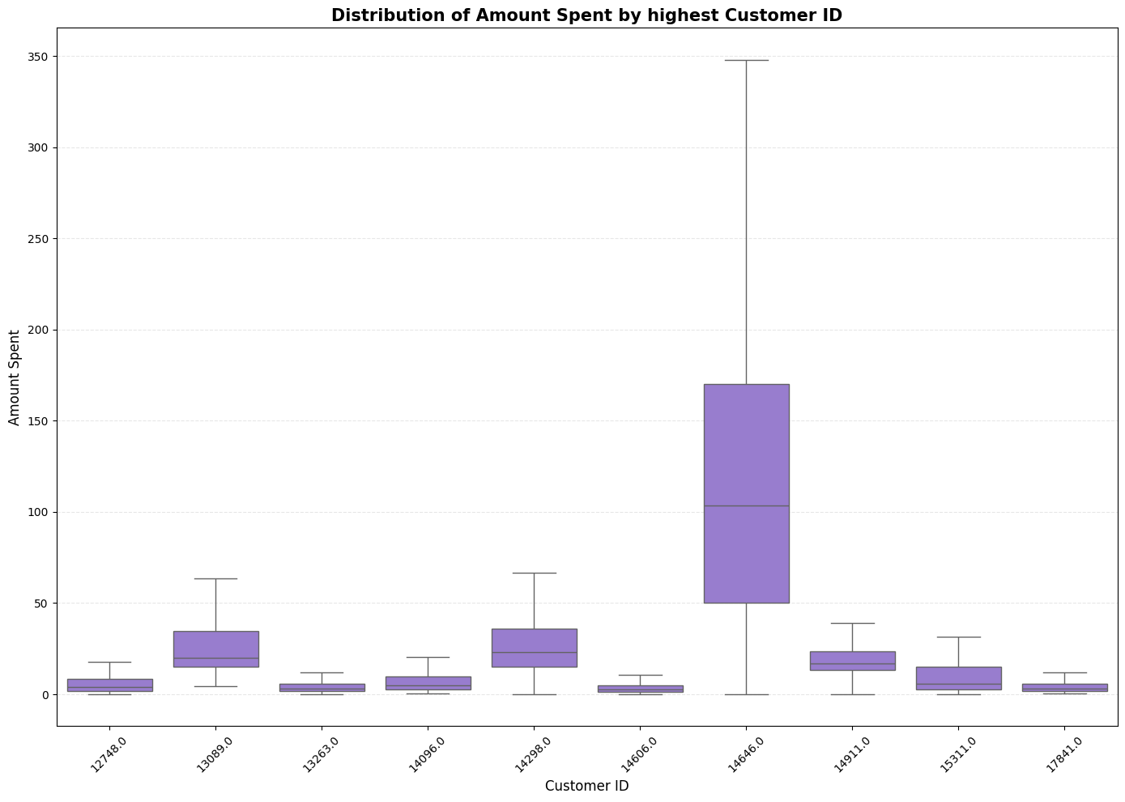
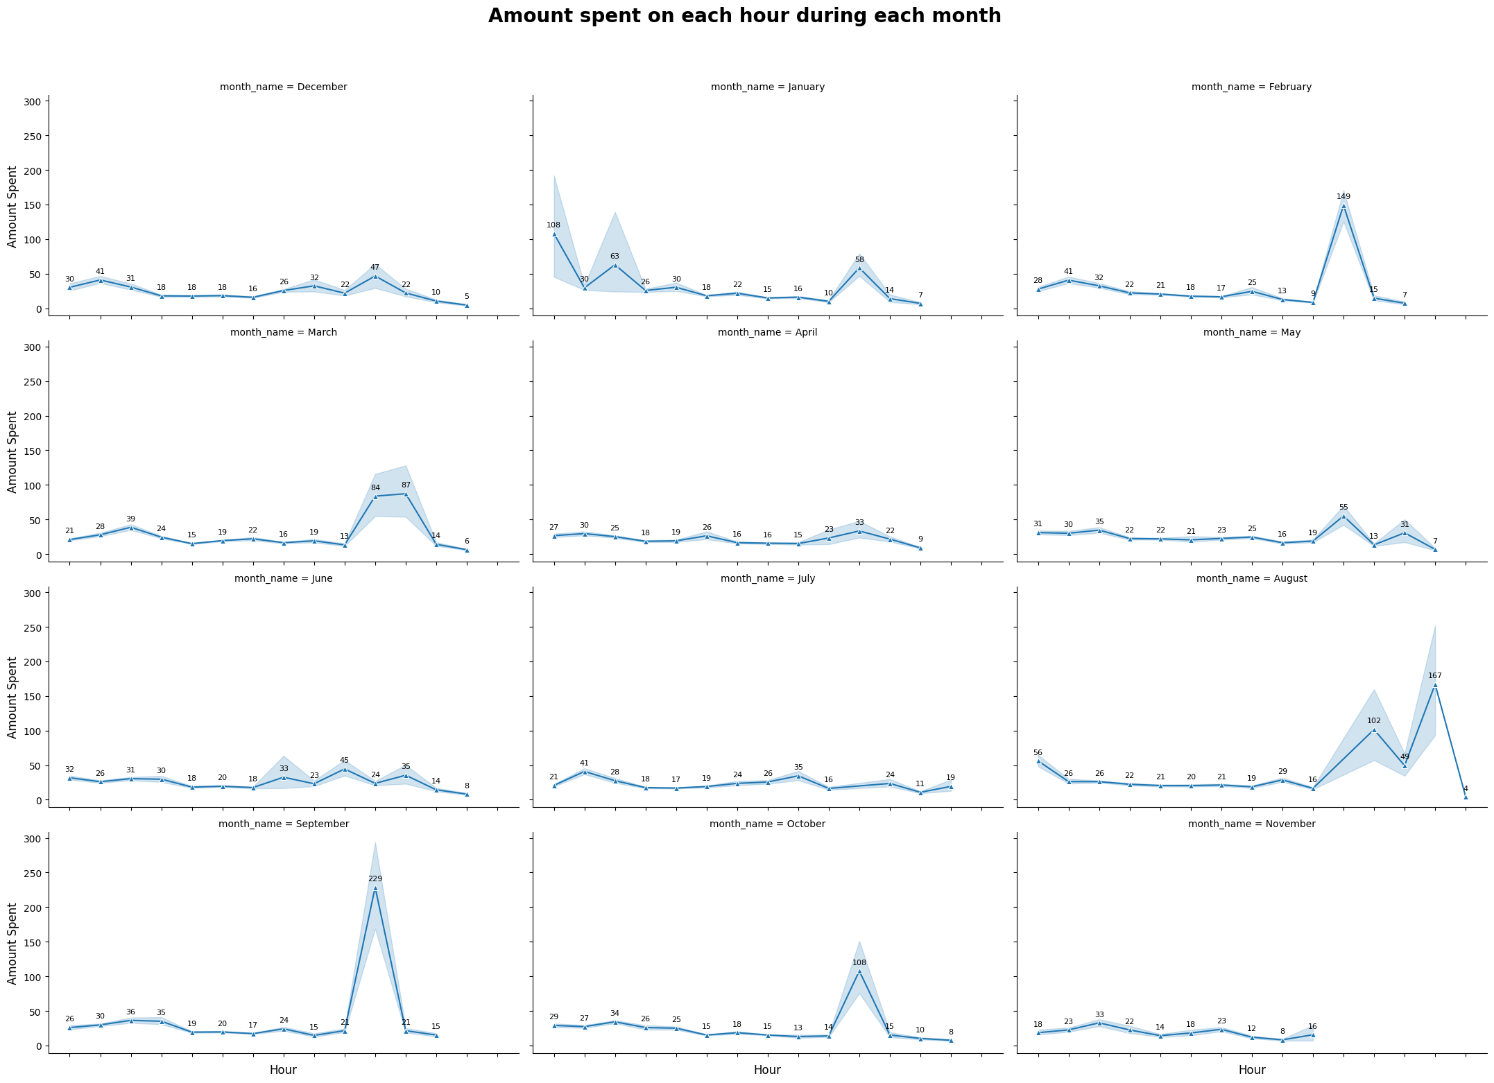
Charts for understanding customers
There is an customer who has an average of $100 of spending as well as we have customers who only spends an average of 5 - 7 dollars on every purchase.
The most amount of selling happens during evening of the day so we can promote offers in the morning to increase the sales in the morning as well.

Slide 8
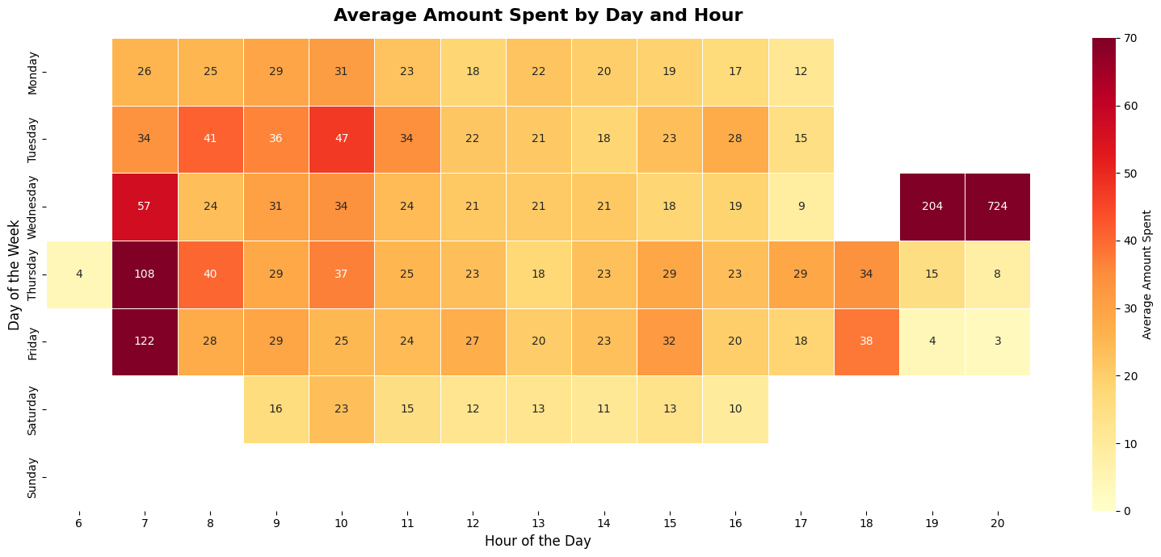
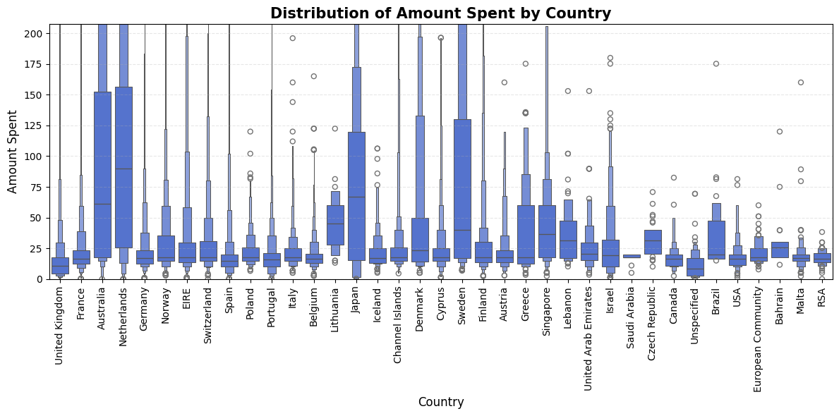
Looking at the patterns on overall
The heatmap shows how invoices varies by weekday and hour.
The countries like Australia , Netherlands , Japan and Sweden have the highest overall spending distributions.
The countries like UK and France shows that they are highly consistent as it has the most amount of spread near the boxes.

Slide 9
Conclusion
This EDA mainly focuses on the usage of various types of charts that are easy to explain , easy to use , and provides a clean presentation.
Invoice activity is higher around 10 AM to 3 PM, showing that daytime is an important shopping period in the dataset.
Shopping activity and spending appear stronger during October to December, indicating a possible seasonal pattern.
A higher number of invoices does not always mean higher total revenue. Both transaction volume and amount spent should be analysed.
Businesses can use these insights to plan seasonal promotions, improve marketing strategies and understand customer purchasing patterns.

Slide 10
Thank You

